Slide 1

Topic:Organic farming market place
Team presented by:
G.Akshith Reddy
S.Bhanu Prakash Reddy
K.Raghu Vardhan reddy
A.Sai Siddhartha

Slide 2


Slide 3
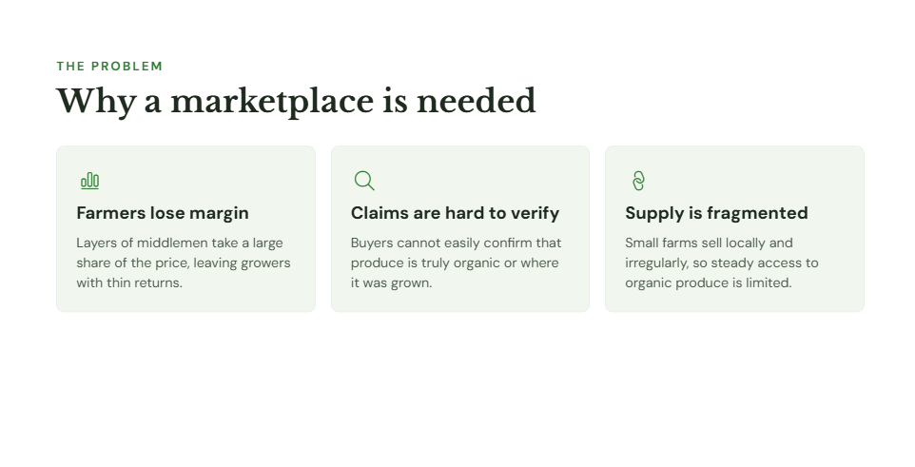

Slide 4
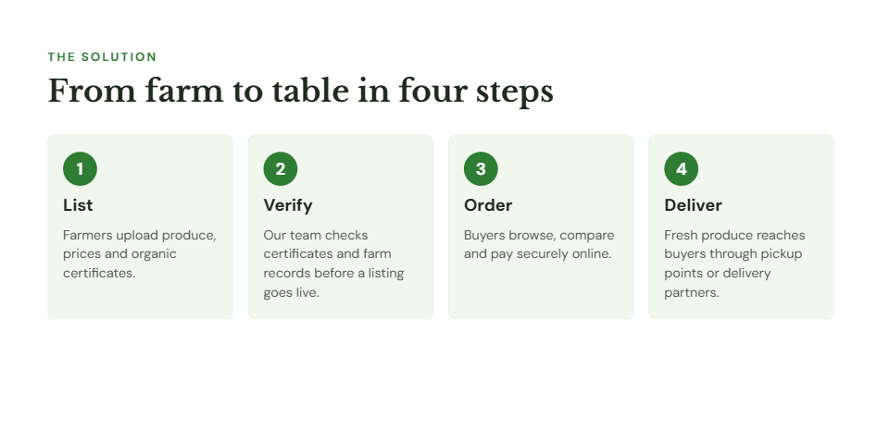

Slide 5
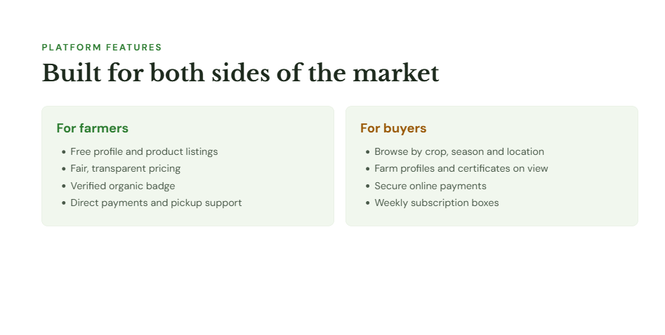

Slide 6
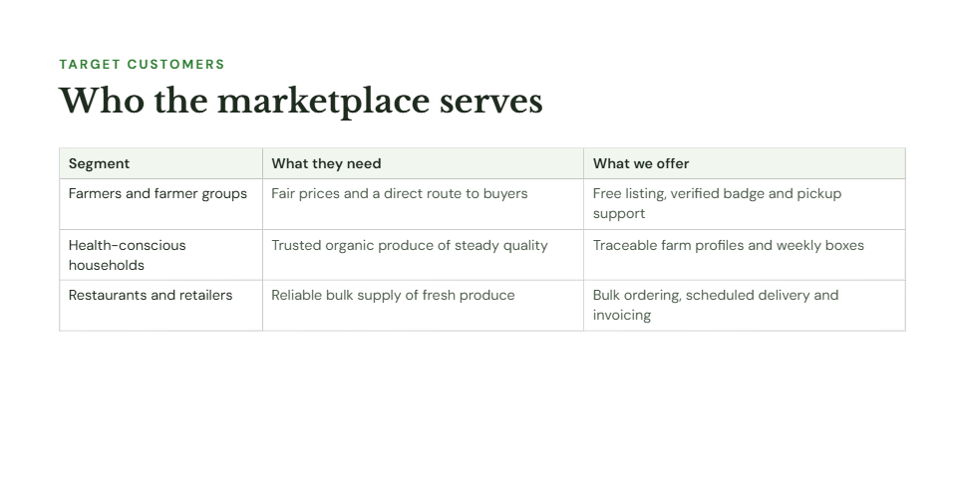

Slide 7
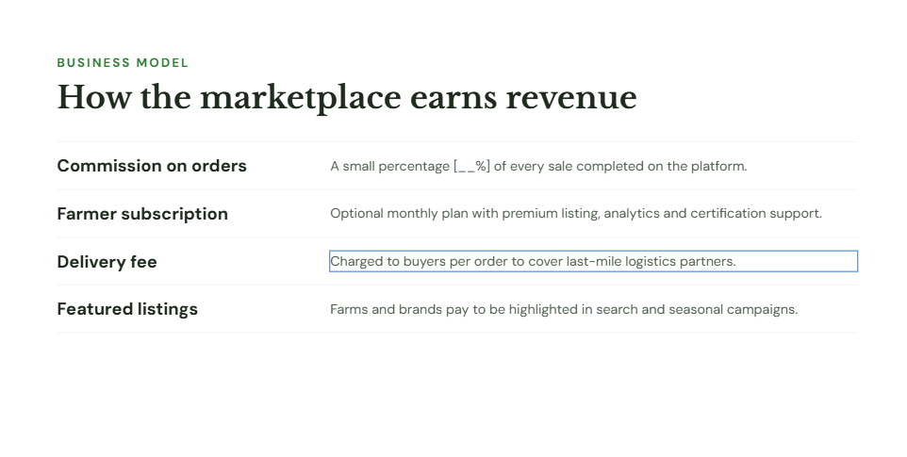

Slide 8
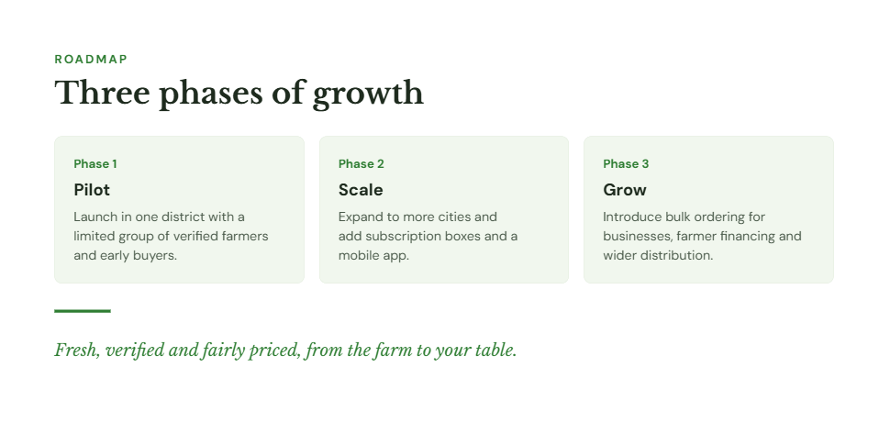
THANK YOU

